Slide 1

REMI
(Smart Pill Reminder)
Team Monado Solutions:
Ladimer Elyeh
Jon Andrew Hernandez
Navjot Bola
Shivani Aurora
Notes:
Good afternoon everyone, I’d like to share something very personal to me, my dad recently had a stroke and a lot of things have changed for him. He went from
0-20 pills overnight and he has to take those pills at the right time every day or else something bad could happen. To make matters worse – we’re 120 miles away from each other so I can’t be there to make sure he takes his pills on time.

Slide 2
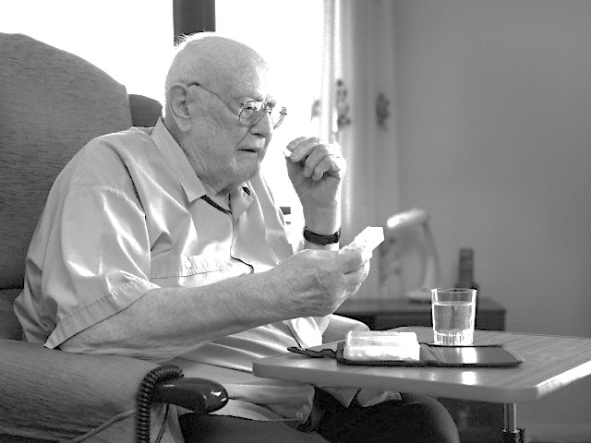

PROBLEM & SOLUTIONS
Forgetfulness
Lack of Attentive Care
Too many medicines
Tend to forget and miss on vital dosage intake
Person needs to be present physically to check on patient
High chances of
mix-up and hence fatal consequences
REMINDERS
REAL-TIME UPDATE
ORGANIZE
Notes:
Let us look a lil deeper into the problems Andrew just mentioned
1st with so much going on in our lives, there are high chances that we tend to forget taking pills at the right time
2nd – not everyone of us are living with our loved ones and hence we get CONCERNED more about them if they are taking the medicatiosn on time – very imp for them
3rd – For a person who takes too many pills,

Slide 3
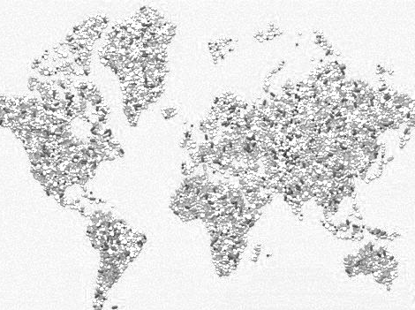
221,200,000
70% of American population have been prescribed at least one medication
Notes:
Based on the research, 70% of healthcare issues can be resolved much faster and much easier if people take pills at the right time
We spoke with people from different age groups
Lets look at the combination of their thoughts and our ideas

Slide 4


REMI
Smart Pill Reminder
Innovative
Cloud-based
Portable
Notes:
Hence we present to you our innovative, vloud based and portable device – REMI
Which wil take care of these problems

Slide 5

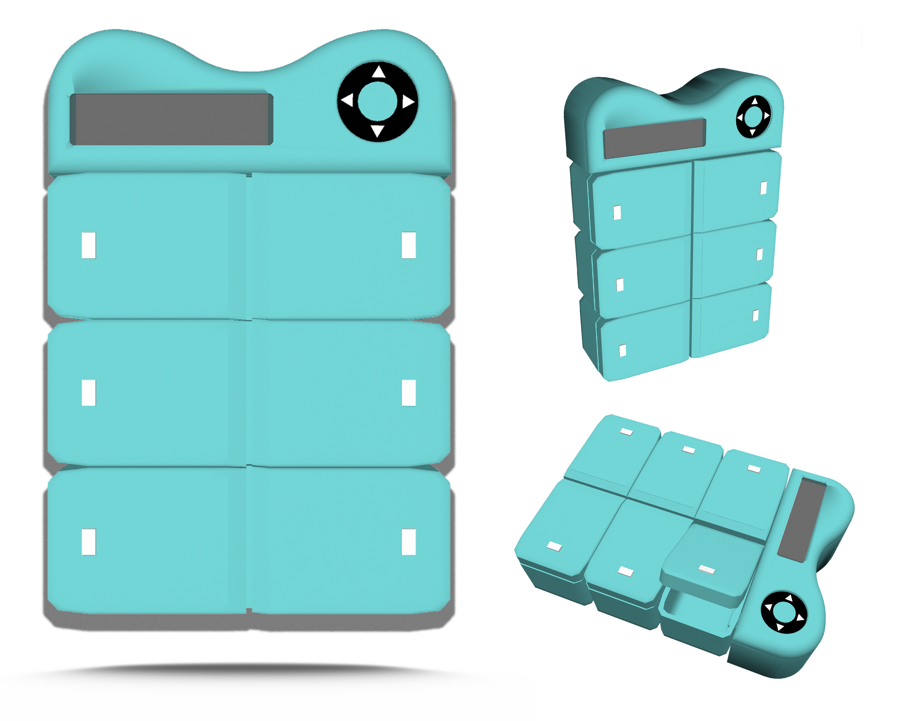
THE PRODUCT: REMI

Slide 6


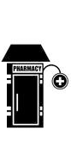


TARGET MARKET
PEOPLE
SERVICES
YOUNG
HEALTHY
OLD / ILL
PHARMACY
DOCTORS

Slide 7


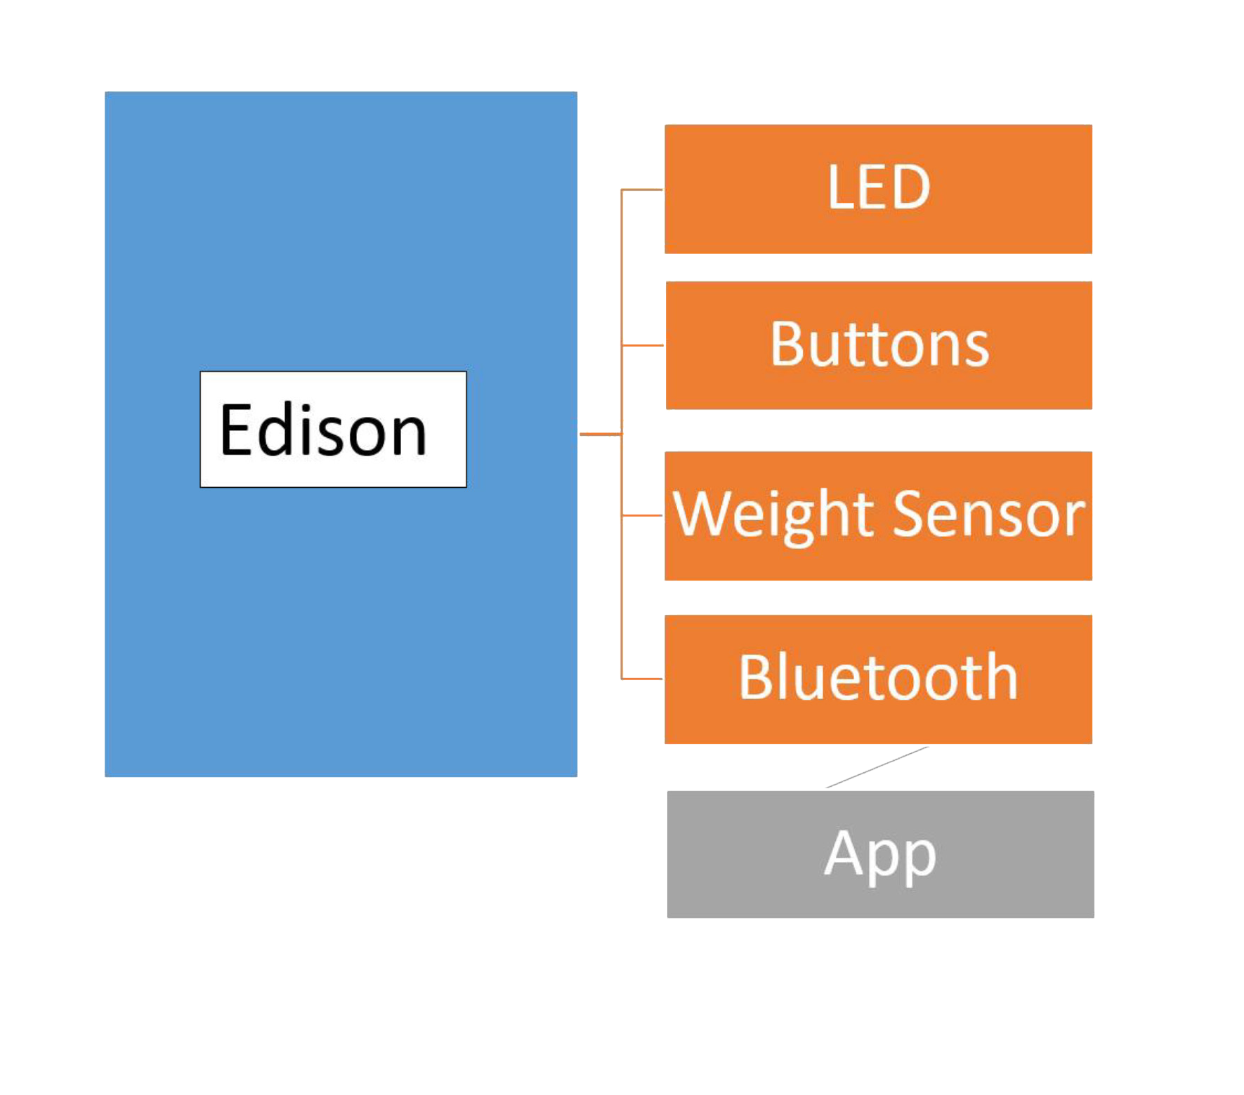



VALUE PROPOSITION
Real-time, non-invasive reminders on device & apps, configure before or after as you want
Cloud-based intake history provide access to trusted loved ones (F&F, doctors) so that they worry less
Sensors track the exact dosage out so that you are sure that when you took it and when you need to take it
LEDs on respective containers guide you to the exact medicine which is due so that you don’t mix-up
Notes:
1) Set real time non invasive REMINDERS - throgh device / app
2)Connectivity to App & cloud – track medication history + no overdose
3) Sensors track the exact dosage out + track - what and when
4) LED – guides you to right container

Slide 8
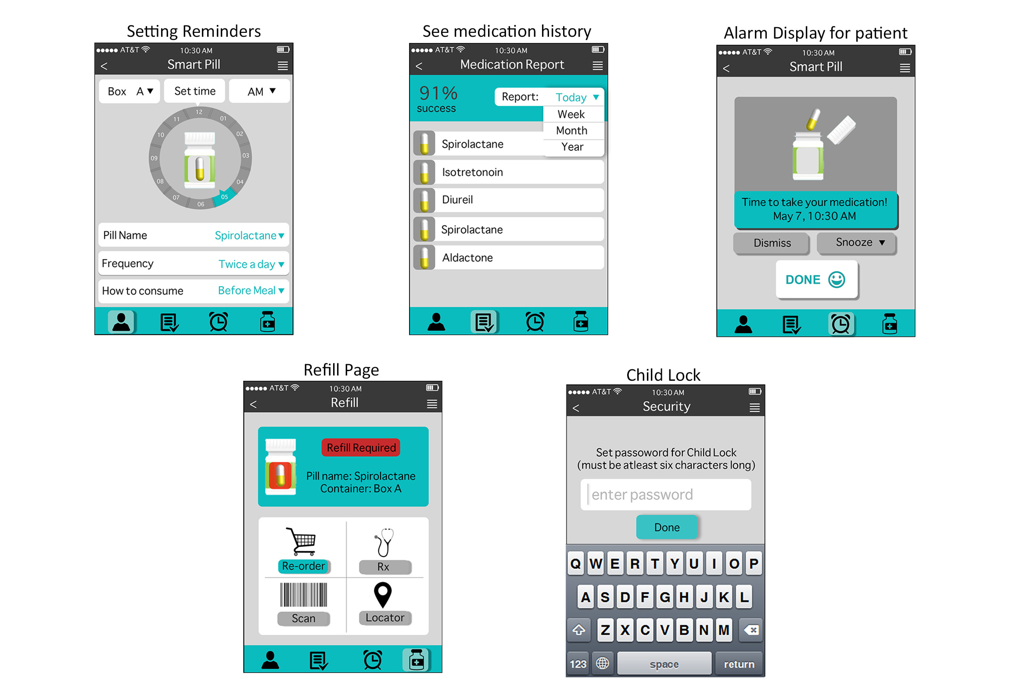
DESIGNS FOR APP

Slide 9
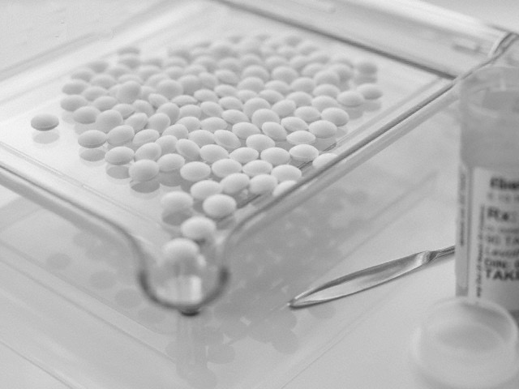
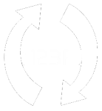

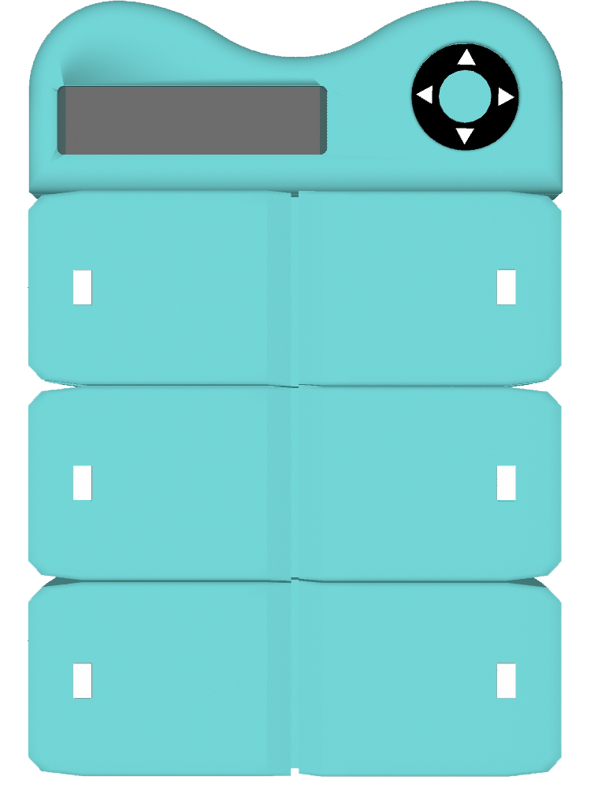

DIFFERENTIATORS
Innovative auto re-fill mechanism allows pharmacy to re-fill your prescription so you never run out
Easy to personalize with detachable containers to suit your changing needs
Portable and sleek design so that you take it where you need it. Child-lock to prevent faulty access
$
More on fulfilling your everyday vital needs, less on price
Notes:
We have done thorough research and there are some products in the market but we have some very key differentiators in our product.
Refill
For everyone
Portable + child lock
price

Slide 10
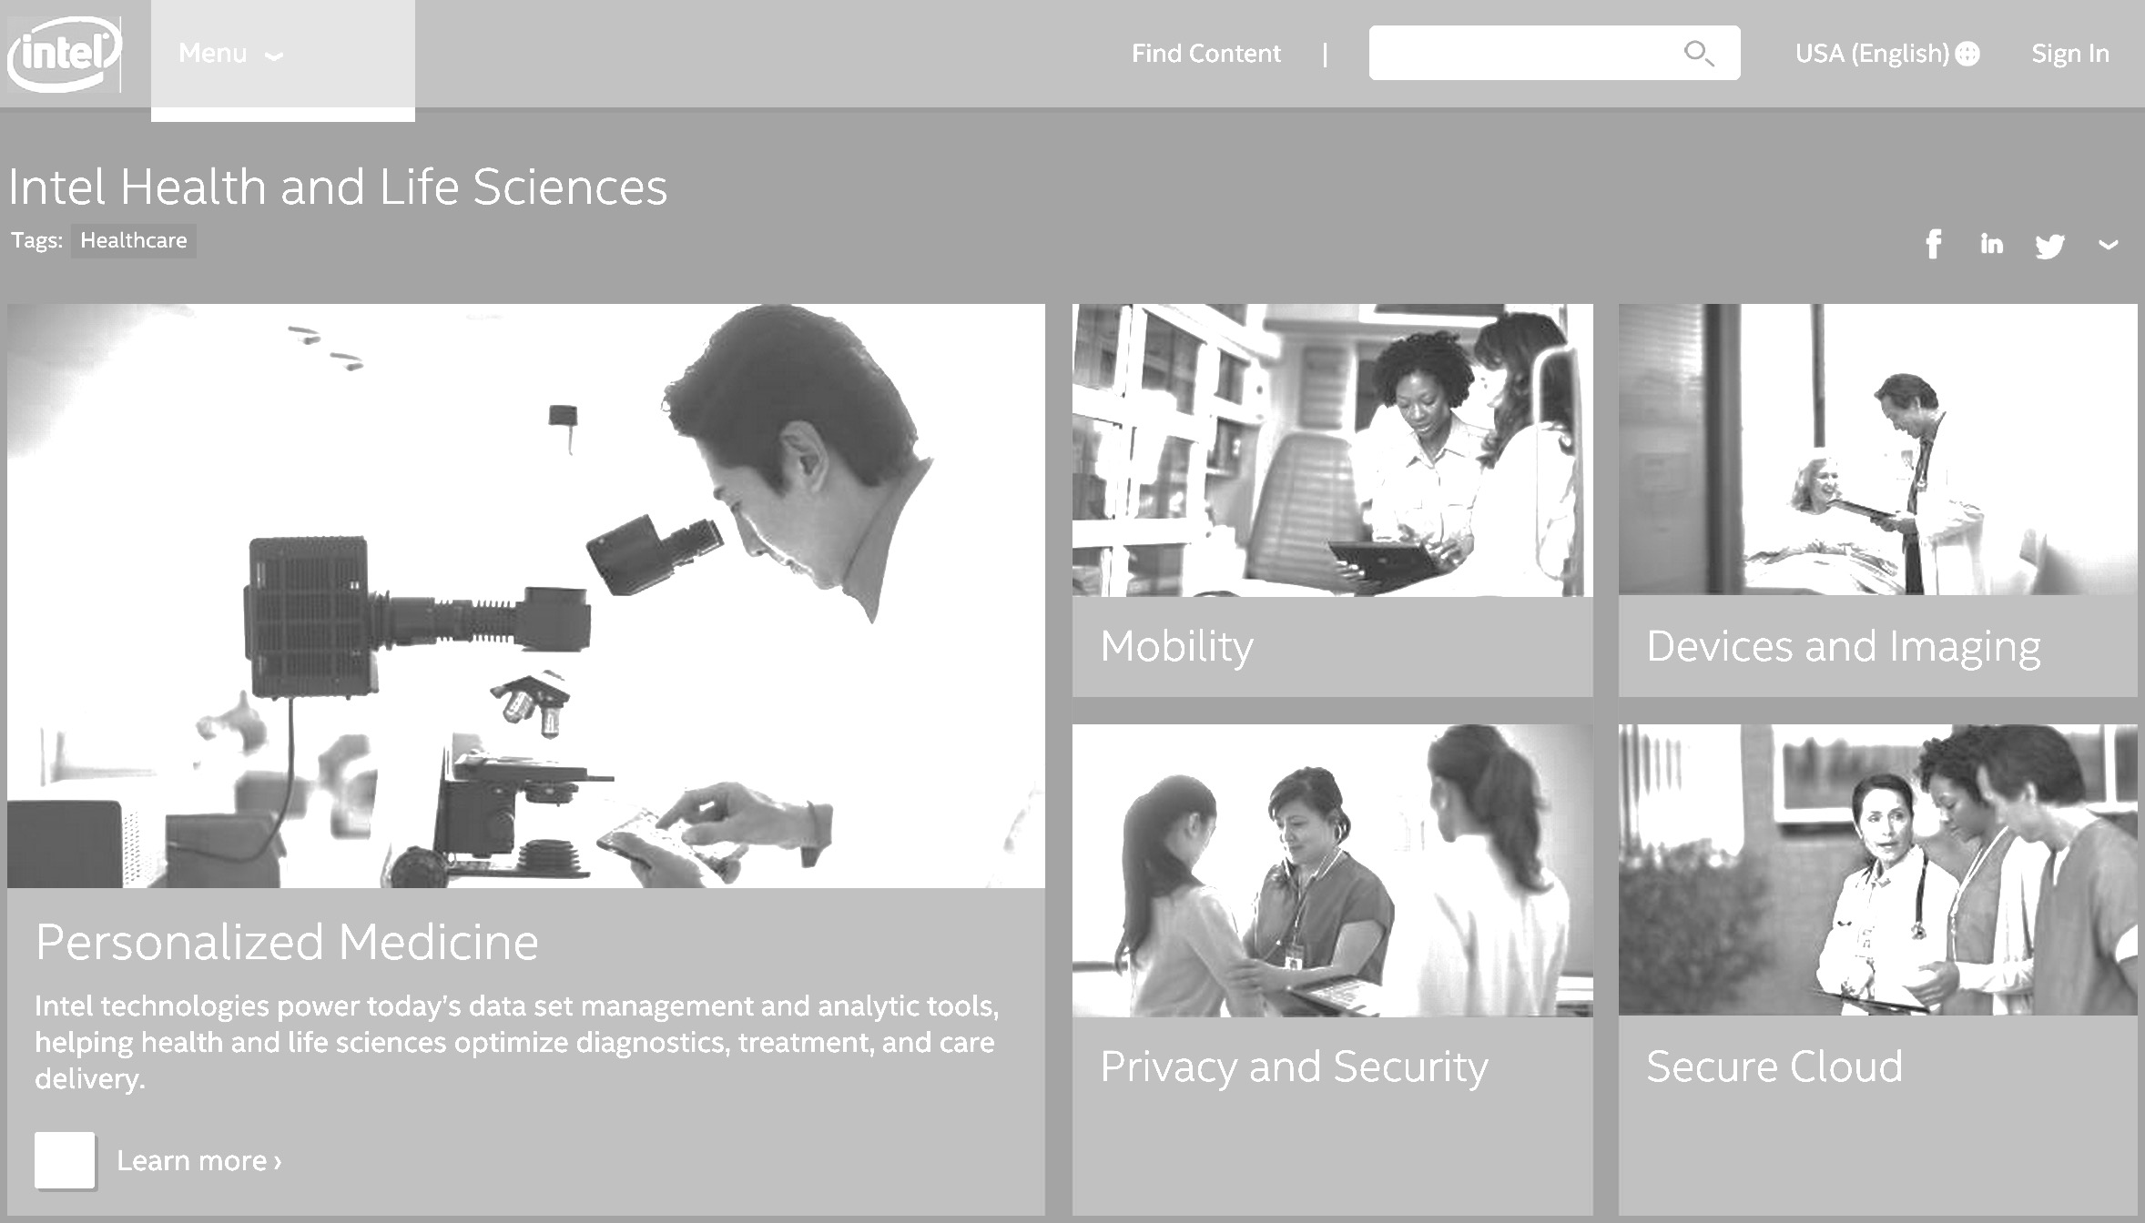
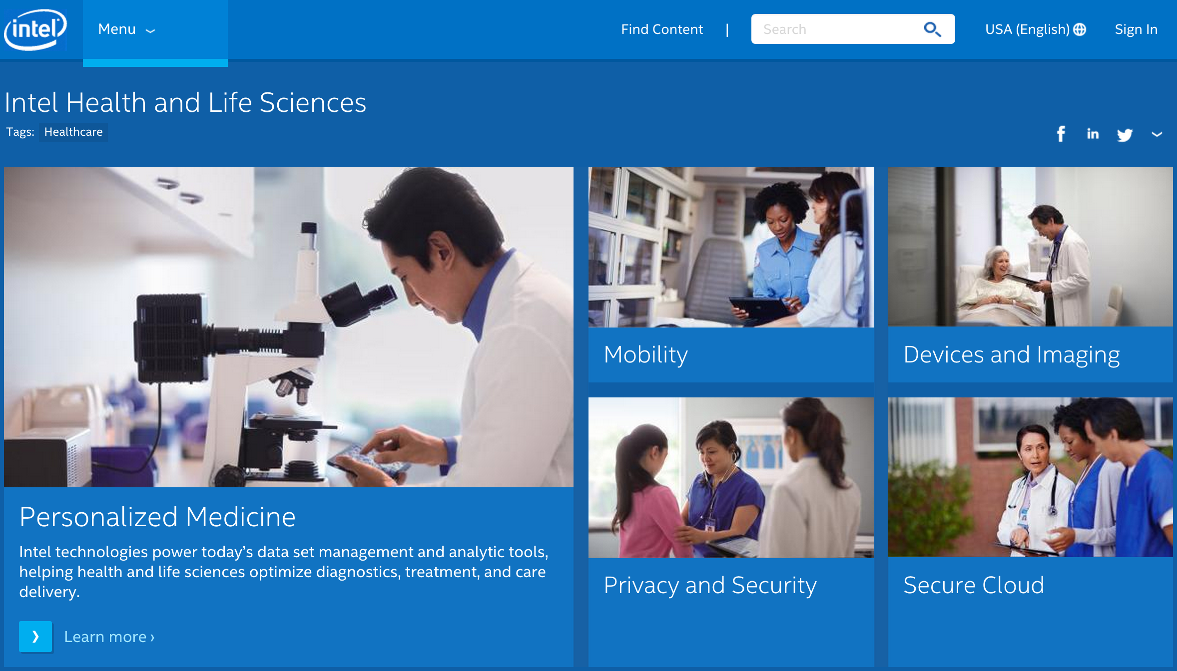
WHAT’S IN FOR INTEL?
Strategically aligns with Intel’s initiative to develop a healthcare delivery system as an ecosystem where technology plays a role in:
Empowering patients and smart care teams and networks
Developing patient-centric application of “care anywhere.”
Intel Corporation’s vision is to deliver innovative computing technologies and solutions that will improve the quality of healthcare delivery and access while reducing unnecessary costs for billions of people worldwide. Intel teams with governments, healthcare organizations, and technology innovators worldwide to build tomorrow’s health IT tools and services.
Notes:
Healthcare is a billion-dollar industry
Intel is one of the key players
Browsing through Intel site – I saw they are working on Privacy, Security, Secure CLoud
Our product is strategically aligned with the Intel initiatives in the field of healthcare, using the power of INTEL EDISON

Slide 11

PARTNERSHIP
(Bigger Picture)
Doctors
Prescribe further course appropriately by accessing patient’s dosage
intake history
Pharmacies
Attract patients by offering this device
Retain patients using auto re-fill mechanism
Prepare inventory in advance by reorder info
Insurance Companies
Prevent excessive bills by offering this device to patients
(preventive care)

Slide 12
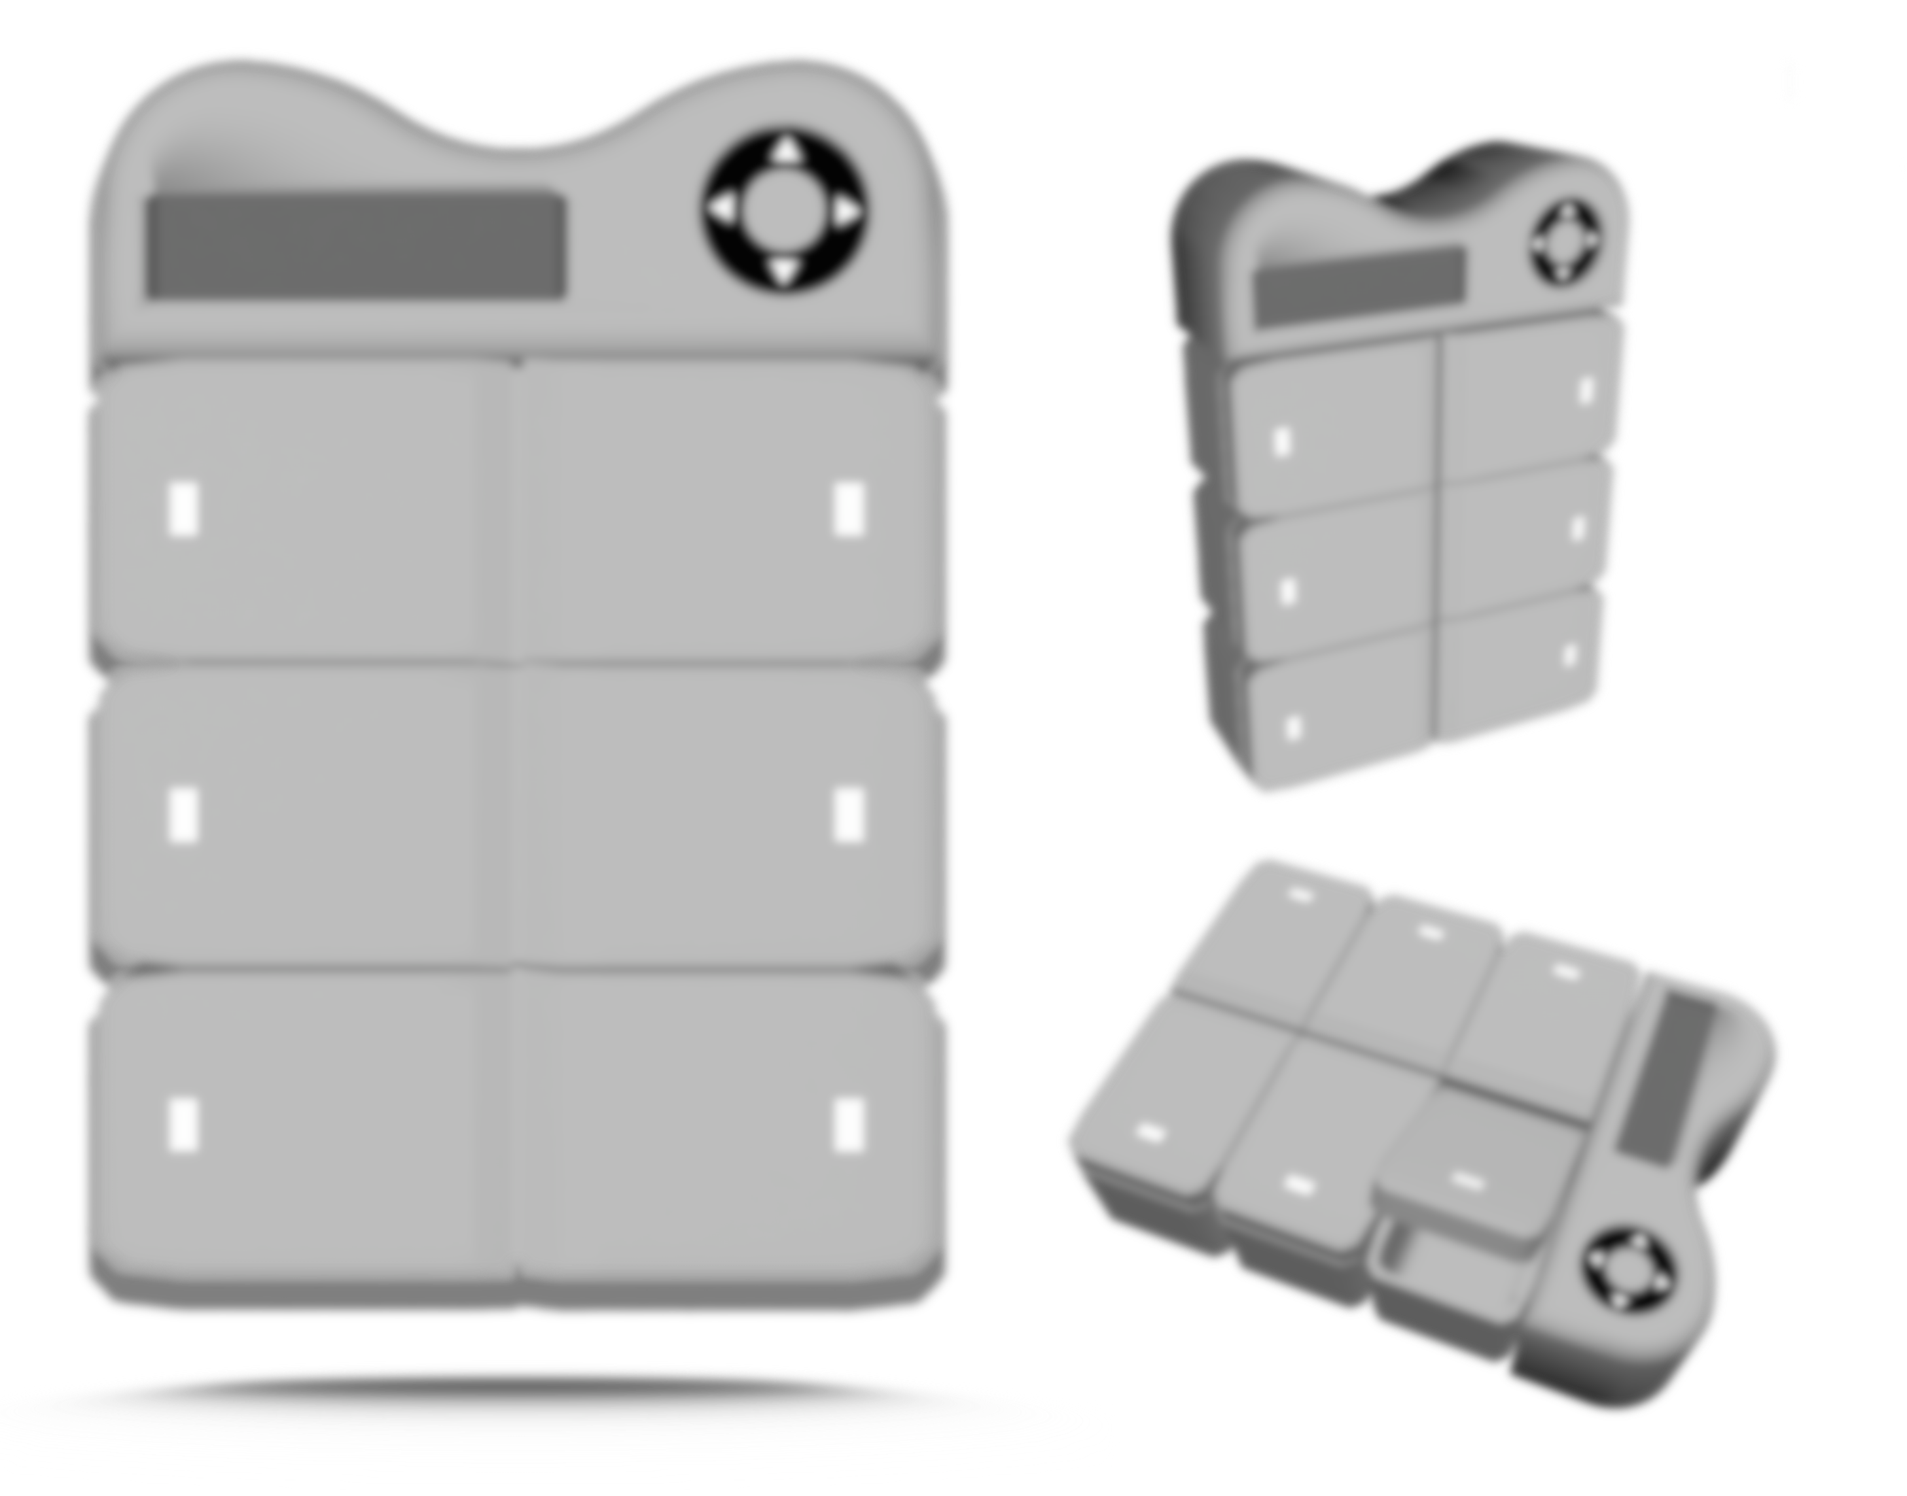
THANK YOU

